Slide 1
Belgium Toy review
YTD August 2023
October 3rd, 2023

Slide 2
NPD and IRI have merged, we are now:
COMPLEXITY INTO CLARITY

Slide 3
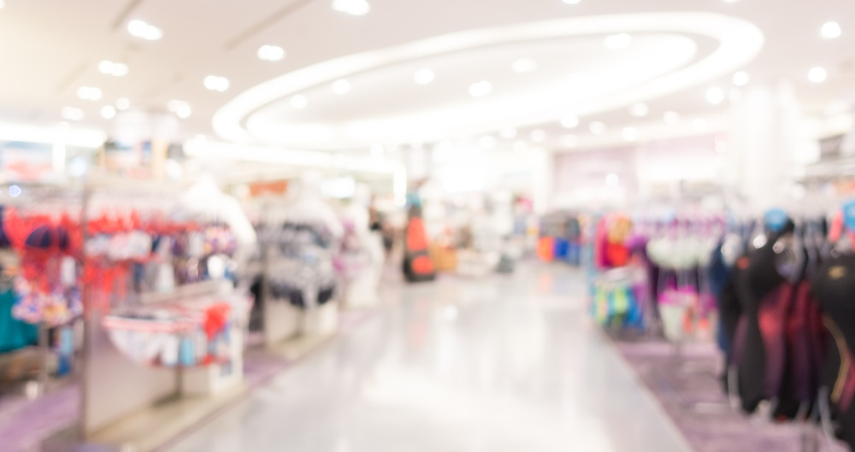
Belgium toy market decline (-8%) is driven by volume drop
Value
Units
ASP
-9%
YoY
-11%
YoY
+2%
YoY
-4%
YoY
-6%
YoY
+2%
YoY
EUROPE 7
Source: Circana Retail Tracking Service, € Projected, EU7, YTD AUG 23
Notes:
La Belgique est impacté par les volumes .
Volume vs 2019: -22%

Slide 4
On a long tail, kids don’t snub toy, it just go back to pre-covid standards
+20%
21 vs 19
Flat
vs 19
Source: Circana | Retail Tracking Service | Belgium | YTD August 23
Notes:
+20% croissance Belgique 2
Volume vs 2019: -22%
1 vs 2019

Slide 5
Toy market impacted this year by calendar effect
Easter resisted well considering only one week of sales ( +3%)
Weekly sales €M
Source: Circana | Retail Tracking Service | Belgium | YTD August 23
Notes:
Effet décalage de date
Congés de Carnaval
Pâques: Pâques qui ne tombent plus à Pâques.

Slide 6
Top 3 headwinds
External and internal reasons
Outdoor
impulsion
novelties
-20%
-13%
-17%
17% share but 42% of the market decline
Outdoor impacted by weather and price points
<10€
15% share in value
48% share in volume
All price points have been impacted
23% of sales
Due to last year over-stock, prefall innovations were under-indexed
Source: Circana | Retail Tracking Service | Belgium | YTD August 23
Notes:
Loutdoor n’est plus la catégorie la plus forte

Slide 7
Top 3 tailwinds
Kidult still an opportunity for the toy market
Construction
Kidult
Easter week
+3%
+1%
+3%
19% share
Only growing category with Infant/Preschool
Toy designed for older age groups
Building Sets, Adult Games/Puzzles/ Collectible figures/etc
Largest prefall peak
Key moment to capture
Source: Circana | Retail Tracking Service | Belgium | YTD August 23

Slide 8
75%
toy sales are made in-store
Down last year (-8%)
but less than Online (-11%).
Source: Circana | Retail Tracking Service | Belgium | YTD August 23
Circana, Inc. and Circana Group, L.P. | Proprietary and confidential

Slide 9
Growing segments are driven by Construction, Kidults and Preschool
Top Gaining Subclasses in M€
+3%
+23%
+9%
+5%
+28%
Standard Building Sets
PS Figure/Playsets & Acc
Special Feature/Interactive Plush
Junior Building Sets
Family Standard Games
Source: Retail Tracking Service | Belgium | YTD August 2023
Notes:
Standard BS : Lego Icons / Star wars / Lego Speed Champions
PS Figure/Playsets & Acc : Gabby (spin) / Bluey (Spectron) / marvel (Hasbro)
Special feature plush : Magic mixies (Spectron) / Pets Alive (zuru) / Gabby (spin)
Junior BS : Mega bloks junior builder (mattel)

Slide 10
Top 10 Gaining Properties contributing to 81% of market gains
Gabby’s
Dollhouse
LEGO Icons
Disney All Other
LEGO Star Wars
Squishmallows
NEW
+1 ,1M€
+37%
+836K€
+134%
+493K€
+15%
+451K€
+114%
+438K€
LEGO Speed Champions
Magic Mixies
LEGO Super Heroes
Bugatti
Avatar The Movie
+51%
+396K€
NEW
+379K€
+34%
+331K€
+315%
+313K€
NEW
+298K€
Source: Retail Tracking Service | Belgium | YTD August 2023
Notes:
Gabby’s Dollhouse contributes to 7% of the market gains

Slide 11
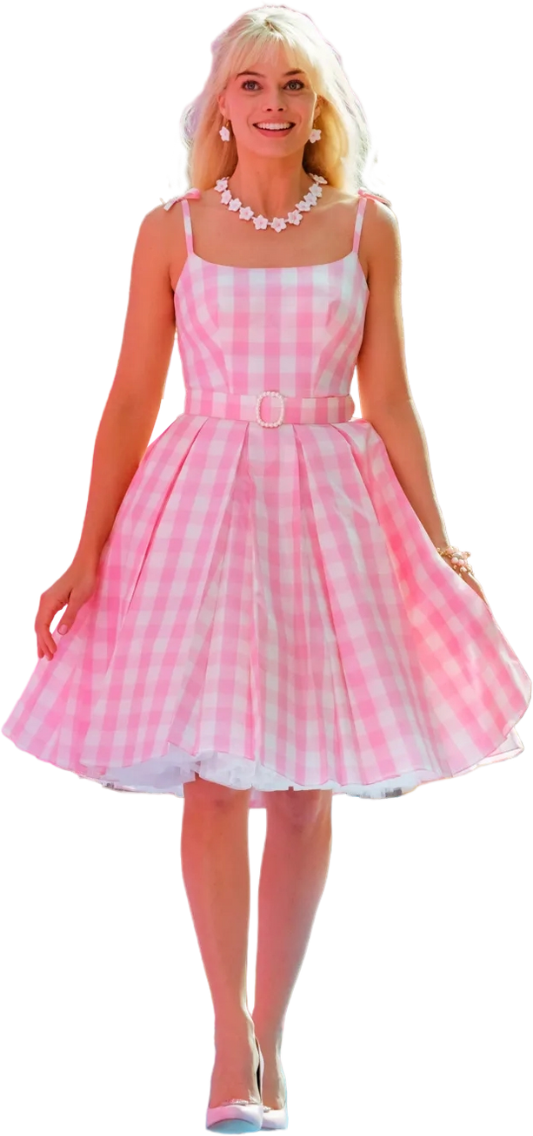
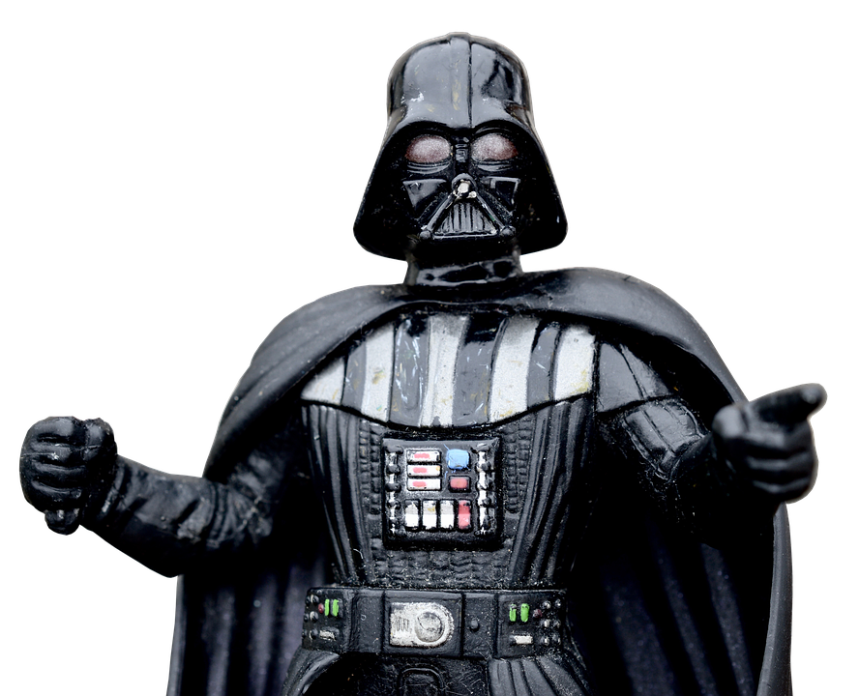
Top 5 best-selling characters
01
02
03
04
05
Pokémon
Star Wars
Marvel
Paw Patrol
Barbie
Source: Circana | Retail Tracking Service | Belgium | YTD August 23
Notes:
Let’s look at the top 5 properties globally so far this year:
We find Pokémon which continues to top the ranks after finishing #1 already in 2022.
Then Squishmallows, SW, the Marvel Universe and then Hot Wheels.
At the time of recording this presentation, the Barbie movie has just come out and Barbie toy sales are raging. So by the time you hear this, I bet she will be back in the top 5.
Pokemon : STCG (78%) with asmodee / Action figures (6%) with funko / Traditionnal plush (5%) with jazwares squishmallows
Star wars : building sets (84%) with lego / AF (5%) with funko
Marvel : building sets (48%) with lego / AF (20%) with Hasbro and funko / PS figure (7%) with hasbro
Paw patrol : PS Figure playsets (42%) with spin / ps vehicles (14%) with spin / ps electronic learning (6%) with Vtech
Barbie : fashion dolls (51%) / fashion Acc(44%)

Slide 12
Q4 expectations
A balance between restriction & emotion
Last minute purchase + calendar effect
Product trends: interactive robots, Micro, collection, newness
License opportunities :
BE: (26%;-7%) vs EU7 (27%; +1%)
environment, sobriety but also
+ shopping pleasure ( Nov 22:-12%)
Source: Retail Tracking Service | Belgium | YTD August 2023
Notes:
To conclude,

Slide 13
Meet the Team
Nicolas PONS
Claire RAVIN
Retail Deputy Europe
Senior Account Manager
nicolas.pons@circana.com +33 6 45 91 18 14
Claire.ravin@circana.com +33 1 41 97 25 21
.

